Slide 1
OGUN STATE MINISTRY OF ENVIRONMENT PRESENTATION ON
WEST AFRICA COASTAL AREAS (WACA) MANAGEMENT PROGRAMME
HELD AT SHERATON ABUJA HOTEL, LADI KWALI STREET, MAITAMA, ABUJA
BY
THE SPECIAL ADVISER TO OGUN STATE GOVERNOR ON ENVIRONMENT
MR. OLA ORESANYA
JULY, 2022

Slide 2
Ogun State is bounded on the west by the Republic of Benin, to the south by Lagos State and a 20kilometre stretch of the Atlantic Ocean, to the east by Ondo and Osun States, and to the north by Oyo State. The extent of the State in the north-south direction at its longest is about 165kilometres, while its width at its widest is about 205kilometres.
1.0 INTRODUCTION

Slide 3
Relief The topography of the State is characterized by highlands to the North and sloping downwards to the South. The highest region is in the North-West and rises to just over 243.9m above sea level. The lowest level is to the South terminating in a long chain of lagoons. The only window to the Atlantic Ocean is to the South East of the State in Ogun Waterside Local Government.
1.0 INTRODUCTION CONTD…

Slide 4
Ogun waterside has an area of 1,000 km² and an estimated population of 103,200 as in 2016 resulting in a population density of 103.2/km². The population growth rate is +3.35% per year. It is bordered by Ijebu East local government to the Northwest, Odigbo, Okitipupa and Ilaje local government areas of Ondo State to the Northeast, East and Southeast respectively, Epe local government of Lagos State to the West, and the Atlantic Ocean to the South.
1.0 INTRODUCTION CONTD…

Slide 5
Ocean storm surge is a natural phenomenon causing coastal changes and destabilizing socio-economic activities along the low-lying Nigerian coastal zone. Storm surges occur periodically along the Ogun State’s coastline. The months of April and August are associated with the development of cyclonic systems far out in the South Atlantic Ocean. These pressure systems usually generate large swells at sea. These swells are associated with rough seas and high waves in the form of surges. On reaching the shoreline, the waves produced by the storms break with high ferocity on the beach.
2.0 SURGES

Slide 6
3.0 SEA-LEVEL RISE.
Probably the main consequence of an increase in global temperatures is an accelerated sea level rise (SLR).
Nigerian coastal zone is broken into barrier lagoon coast, Mahin mud coast, Niger Delta, and Strand coastline.
Ogun State’s coastline is on barrier lagoon coast and comprises of sediments deposited mainly by Yewa, Ogun, Osun, Shasha and Oni Rivers.

Slide 7
3.0 SEA-LEVEL RISE CONTD…
If Lagos and Lekki barrier Lagoon systems harboring large real estate could lose well over 584 and 602square kilometers of land from erosion and inundation (Awosika et al, 1995, such adverse impacts will affect crop farming, livestock rearing, hunting, and fishing, residential, and future commercial and tourist facilities on Ogun State’s coastline that may be valued at well over U.S.$12 billion.

Slide 8
4.0 LIVELIHOOD ACTIVITIES
There are differences in livelihood activities carried out by males and females in the area. As observed in 2006 and 2011, the following summarizes many of the major types of activities carried out by males, females, and youth as reported in the various FGDs and IDIs:
Men- open sea fishing, handling heavy farming tasks such as land preparation, selling palm kernel, cutting timber, hunting, growing tree crops, harvesting palm fruit, and coconut, palm wine tapping;

Slide 9
4.0 LIVELIHOOD ACTIVITIES CONTD…
Women – assisting in farming tasks such as planting and weeding, growing vegetables and tending household gardens, ‘bush-fishing’, processing and selling fish, crafts, processing palm oil and Garri, gathering and selling firewood and other non-timber forest products (NTFPs); and
Youth: fishing with men, trading in general goods, farming, carpentry, welder, bricklaying, transporting.

Slide 10
5.0 COASTAL FLOODING
Coastal Flooding normally occurs when dry and low-lying land are submerged by seawater. The range of a coastal flooding is a result of the elevation of floodwater that penetrates the inland which is controlled by the topography of the coastal land exposed to flooding.
Ogun Waterside, Ijebu East and Ifo Local Governments of Ogun State are renown with this type of flood as they share boundaries with Lagos State along the Water coast areas

Slide 11
5.0 COASTAL FLOODING CONTD..
The proximity of the State to Lagos especially Epe and Lekki will amount to serious environmental degradation of the Ogun State shoreline around Ebute-Imobi and Ebute-Oni due to the volume of sand that was dredged to sand-fill the Lekki Free Trade Zone.
This effect might not be conspicuous now because the communities in the coastal areas are still far from the shoreline and also because most of the shoreline have been overgrown with water hyacinth and trees. However, the effect as indicated in the picture taken at Ebute-Oni can speak volume.

Slide 12
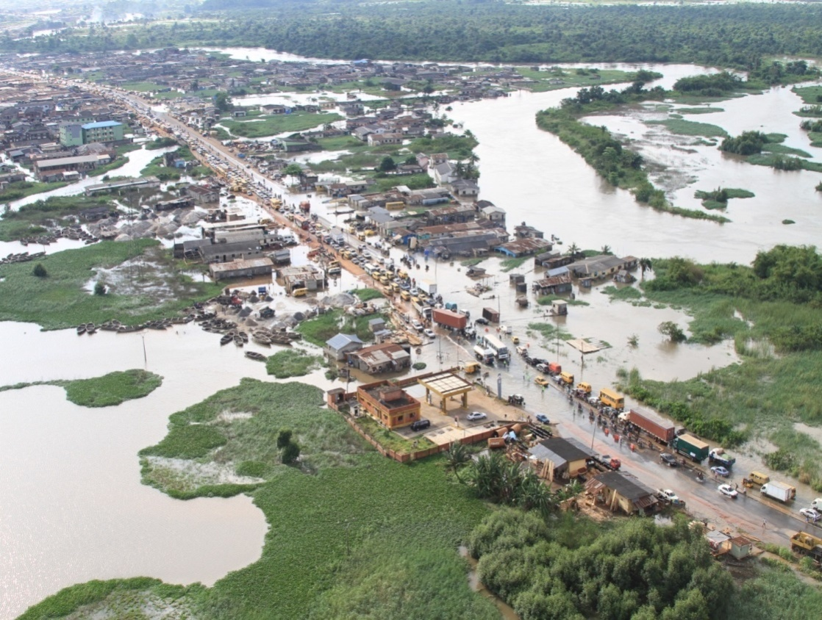
6.0 AN OVERVIEW OF OGUN RIVER FLOODING OF ISHERI ALONG LAGOS-IBADAN EXPRESSWAY

Slide 13
6.1 ISHERI FLOODING

Slide 14
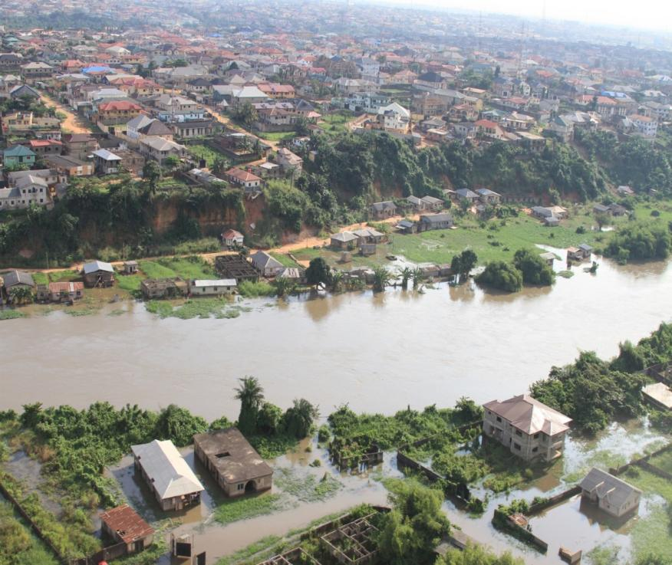
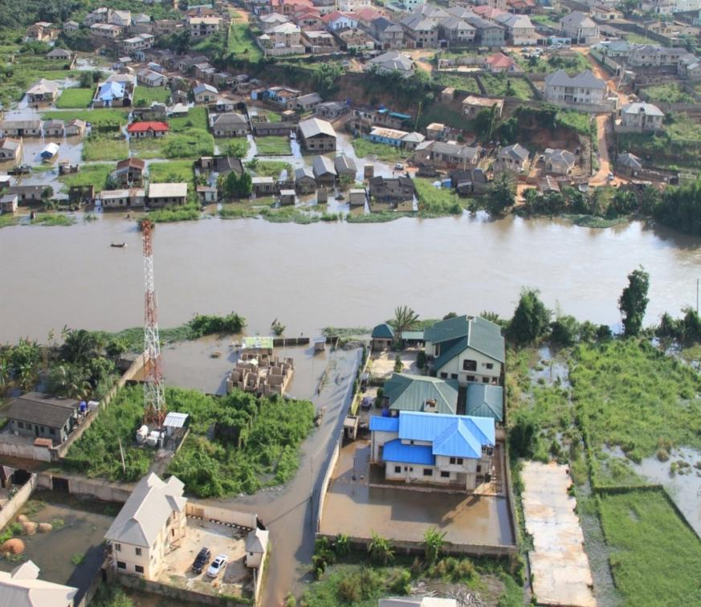
6.1 ISHERI RIVER FLOODING CONTD…
Isheri North Scheme on the right Bank of River Ogun and Isheri/ Magodo Phase 1 on the hill on the left bank

Slide 15
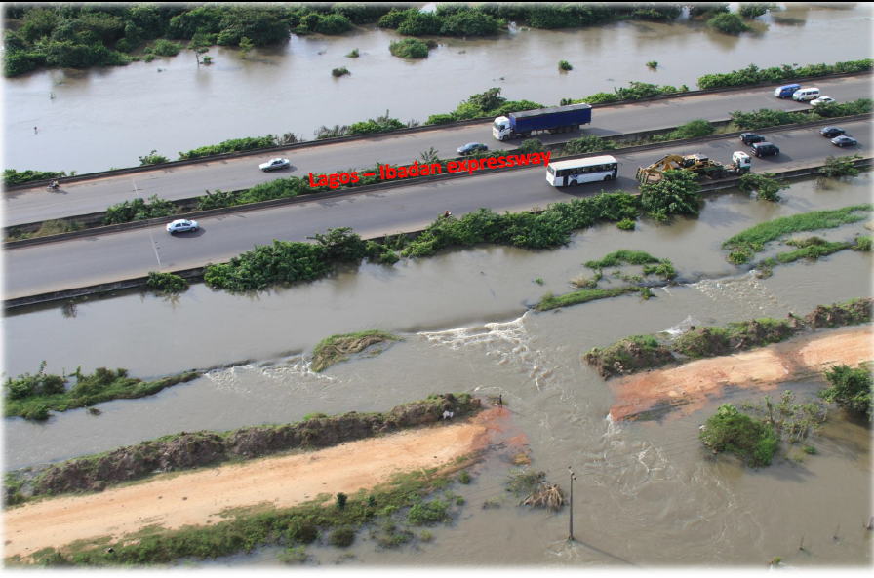
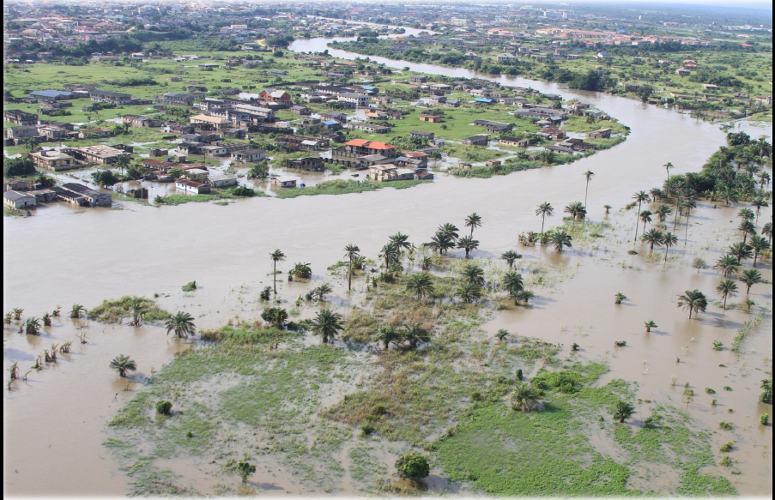
6.1 ISHERI RIVER FLOODING CONTD…

Slide 16
6.2 SUBMERGED CLASSROOMS AT OGD COMPREHENSIVE HIGH SCHOOL, MAKUN-OMI

Slide 17
6.3 EBUTE-ONI

Slide 18
6.4 WATER HYACINTH INVASION OF OGUN RIVER AT KARA
The common problem in Ogun State’s coastal waterways is water hyacinth invasion which inhibits transportation and endangers marine habitat. Recent occurrence was the invasion of lower course of Ogun River area of Isheri, along Lagos-Ibadan expressway Kara in year 2015 which cost the State Government about N50M to evacuate, not to mention the periodic evacuation on the creek waters of the State.

Slide 19
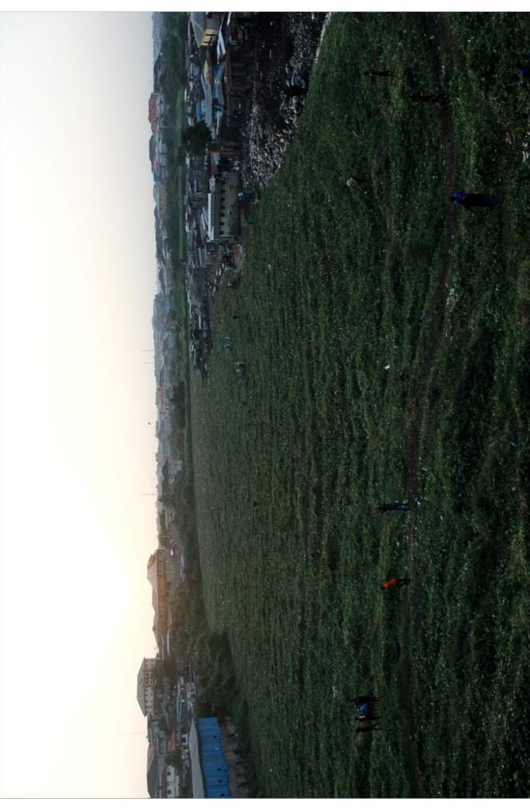
6.4.1 WATER HYACINTH INVASION OF OGUN RIVER AT KARA

Slide 20
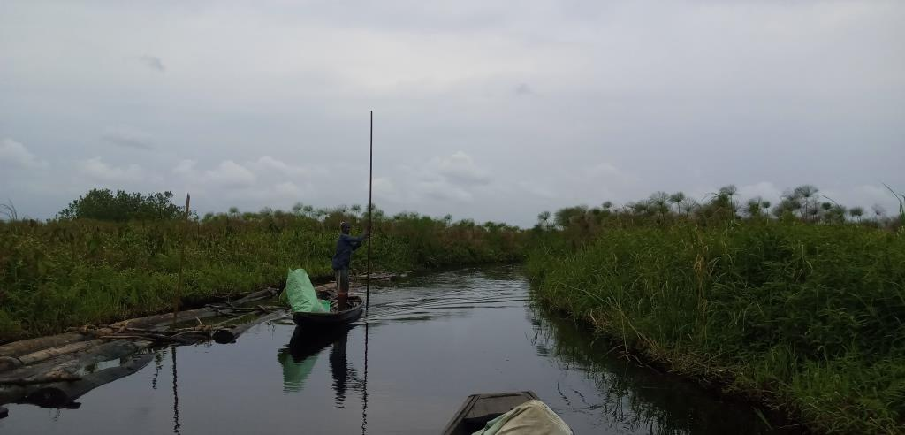
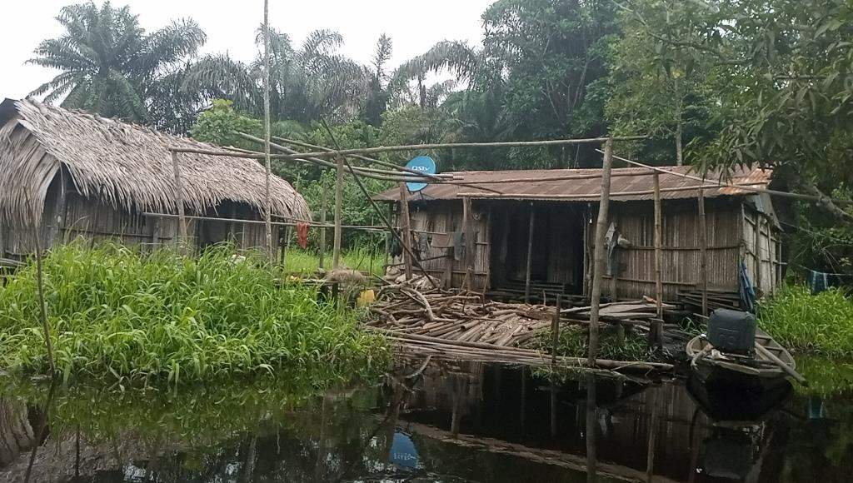
6.4.2 IMOBI RIVER THAT LINK EPE RIVER

Slide 21
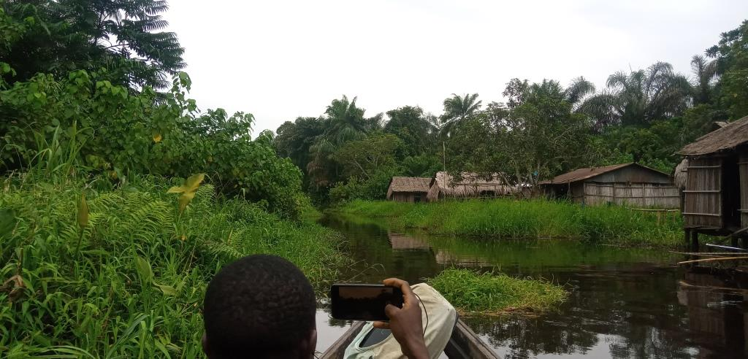
6.4.3 EBUTE-IMOBI WATER HYANCINTH INVASION

Slide 22
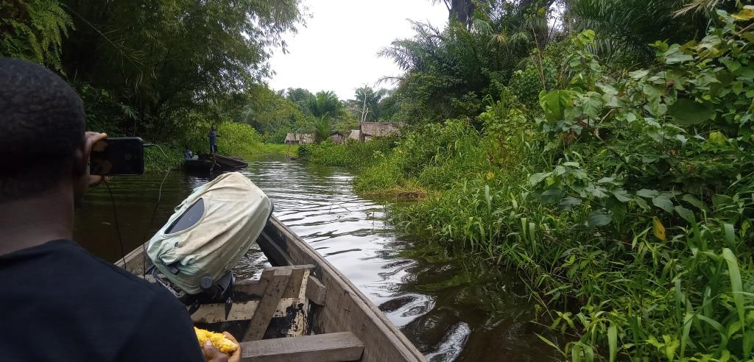
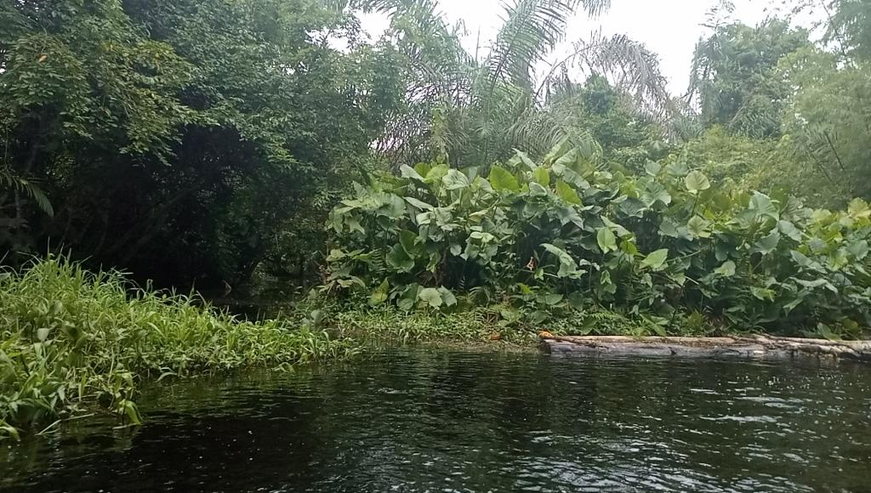
6.4.3 EBUTE-IMOBI WATER HYACINTH INVASION CONTD…

Slide 23
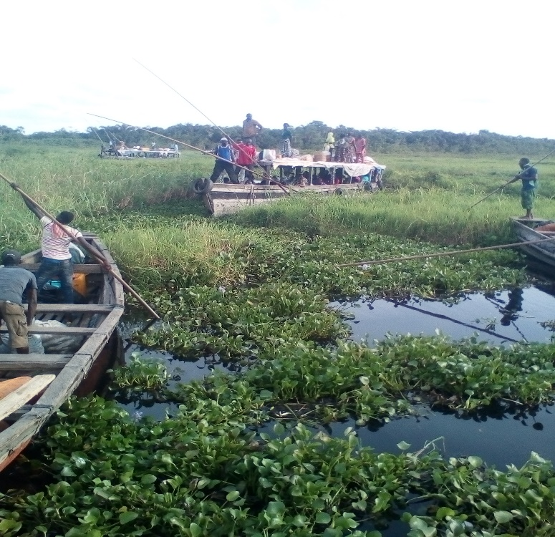
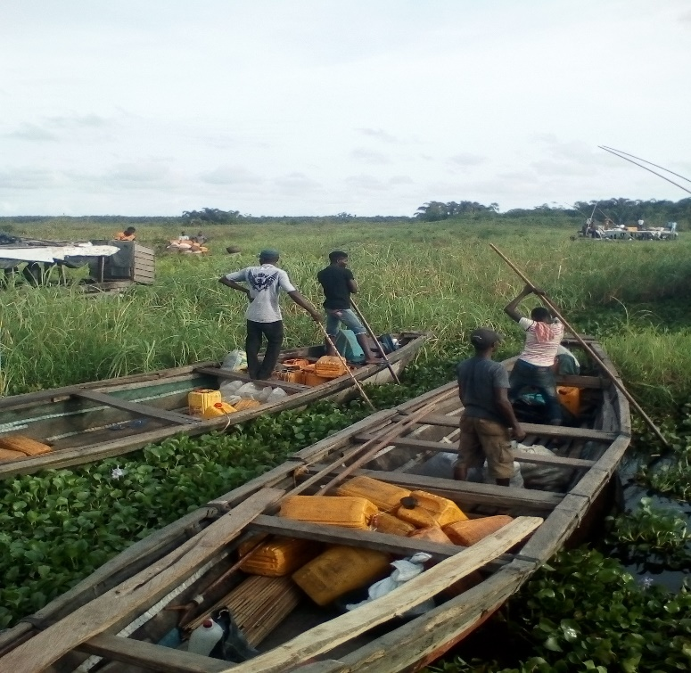
6.5 MAKUN –OMI WATER HYACINTH INVASION

Slide 24
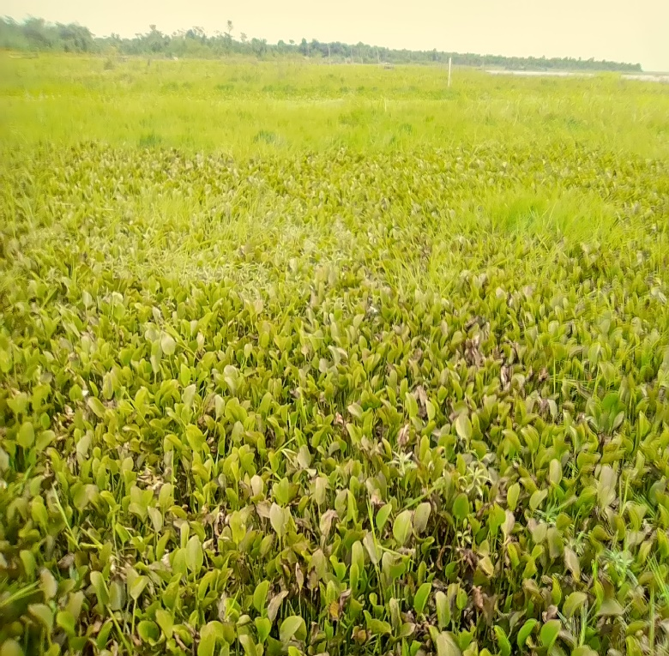
6.6 IWOPIN WATER HYACINTH INVASION

Slide 25
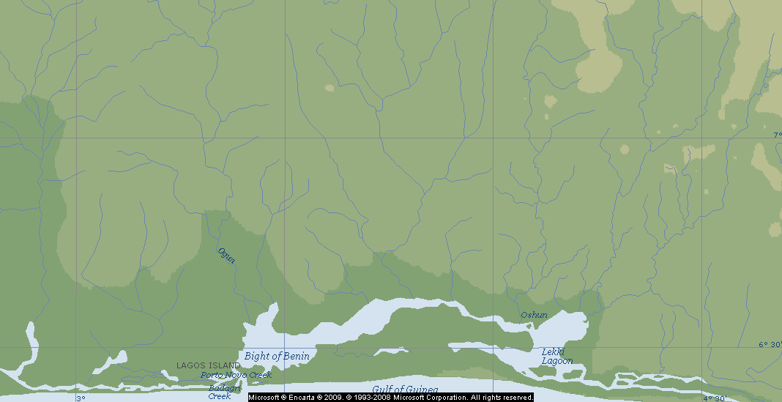
7.0 NETWORK OF RIVERS DISCHARGING THROUGH OGUN STATE INTO LAGOS FROM THE HINTERLAND
R. YEWA
R. OGBERE
R. OGUN
R. OSUN
R. SUNMOGE
Lagos Lagoon
Lekki Lagoon
Ologe Lagoon
Porto Novo Creek
Badagry Creek

Slide 26
8.0 VULNERABLE GROUPS.
People, usually the “poorest of the poor”, who have no control over their means of livelihood.
Female-headed households without farm or fish assets, who do not have any type of formal access to these assets.
The elderly who, even if they own means of production are unable to utilize them to the maximum capacity.
Disabled persons who are unable to engage in conventional income-generating activities and may not have access to alternative opportunities.

Slide 27
8.0 VULNERABLE GROUPS CONTD..
Children who may not have opportunities for advancement since educational facilities are presently lacking
Women fish processors who will have less fish to process/sell in areas where fishing activities are reduced due to project activities the along the coastal area
Both male and female youth, especially the unemployed, are vulnerable to probable increases in certain communicable diseases (e.g., HIV/AIDS) due to development activities.

Slide 28
9.0 QUALITY OF ROADS IN SELECTED COMMUNITIES
Community | Quality of road | Passable all year? | Links community to which other community? | Remarks
Ode-Omi | Poor | Yes | Folu | Not tarred, narrow & rough
Ago Keji | Poor | No
Awodikora | Poor | Yes | Ode-Omi/
Eba | Poor | Yes | Folu Community
Lago | Poor |  |  | Island Community
Isekun | Poor | Yes
Oka | Poor | Yes | Ode-Omi | Long & rough
Ilete | Poor | Yes | Oka | Barely motorable
Oke-oso | Poor | No |  | Very bad in rainy season
Ijegbe | Poor | Yes | Oke-Oso | Roads is full of sand
Olosunmeta | Poor | Yes | Igbosere
Akede | Poor
Igbosere | Poor | Yes
Araromi | Poor | Yes |  | Now reachable by road
Igbeki | Poor | Yes |  | Water-logged during rains
Ise | Average | Yes | Folu | Needs repair

Slide 29
10.0 Comparison of 2006, 2011 and 2014 on Availability and Quality of Primary Schools in Selected Communities
Community | Have Pry School? |  |  | Any changes in 10 years? | Reason for change if any (due to OKLNG intervention?)
 | 2006 | 2011 | 2014
Ode-Omi | Yes | Yes | Yes | Yes | OKLNG provided desks
Ago Keji | No | No
Awodikora | Yes | Yes
Eba | Yes | Yes | Yes | Yes | LGA renovated building; OKLNG supplied chairs, pencils, notebooks
Lago | No | No
Isekun | Yes | Yes | Yes | Yes | Renovated, but not by OKLNG
Oka | Yes | No
Ilete | Yes | Yes
Oka | No | No
Oke-Oso | No | No
Ijegbe | No | No | No
Olosumeta | No | No | Yes
Akede | No | No
Igbosere | Yes | Yes
Araromi | Yes | Yes
Igbeki | Yes | Yes | Yes | None | ------
Ise | Yes | Yes | Yes | No | ------
Obada | Yes | No
Igbogun | Yes | Yes | Yes | Yes | 10 More classrooms were build
Mafogunde | No | No | No | No | ------
Ogogoro | No | No

Slide 30
11.0 Availability and Quality of Secondary Schools in Selected Communities
Community | Have Secondary School? |  |  | Any changes in 10 years? | Reason for change if any
 | 2006 | 2011 | 2014
Ode-Omi | Yes | Yes | Yes | Yes | OKLNG provided desks
Ago Keji | No | No
Awodikora | No | No
Eba | No | No |  | None
Lago | No | No
Isekun | No | No |  | None
Oka | No | No
Ilete | No | No
Oka | No | No
Oke-Oso | No | No
Ijegbe | No | No | No | None | ------
Olosumeta | No | No | No | None | ------
Akede | No | No
Igbosere | No | No
Araromi | Yes | Yes
Igbeki | No | No | No | None
Ise | Yes | Yes | Yes | None
Obada | No | No
Igbogun | Yes | Yes | Yes | Yes | 12 More classrooms built
Mafogunde | No | No | No | None
Ogogoro | No | No

Slide 31
12.0 Source of Water for Residents in Selected Communities for 2011 and 2014
*Boreholes provided at Ode-Omi by Lagos and Ogun State Governments
**Solar borehole provide but not functioning
Community | Private Borehole |  | Private Wells |  | Public Boreholes |  | Public Wells |  | Creek/Stream/Ocean |  | Rain Water |  | Any change
 | 2011 | 2014 | 2011 | 2014 | 2011 | 2014 | 2011 | 2014 | 2011 | 2014 | 2011 | 2014
Ode-Omi | No | No | Yes | Yes | No | Yes | No |  | Yes | Yes | Yes | Yes | More bhs*
Ago Keji | No |  | Yes |  | No |  | No |  | Yes |  | Yes
Awodikora | No |  | Yes |  | No |  | Yes |  | Yes |  | Yes
Eba | No | No | No | No | No | No | Yes | Yes | Yes | Yes | Yes | Yes | None
Lago | No |  | Yes |  | No |  | No |  | Yes |  | Yes
Isekun | No | No | Yes | No | No |  | No | No | Yes | Yes | Yes | Yes | None
Oka | No |  | No |  | No |  | No |  | Yes |  | Yes
Ilete | No |  | Yes |  | No |  | Yes |  | Yes |  | Yes
Oka | No |  | Yes |  | No | No | No |  | Yes |  | Yes
Oke-Oso | No |  | Yes |  | No |  | No |  | Yes |  | Yes
Ijegbe | No | No | Yes | Yes | No |  | No | No | Yes | Yes | Yes | Yes | None
Olosumeta | No | No | No | No | No | No | No | No | Yes | Yes | Yes | Yes | Noe
Akede | No |  | Yes |  | No | No | No |  | Yes |  | Yes
Igbosere | No |  | No |  | No |  | Yes |  | Yes |  | Yes
Araromi | No |  | Yes |  | No |  | Yes |  | Yes |  | Yes
Igbeki | No | No | Yes | Yes | No | No | No | No | Yes | Yes | Yes | Yes | None
Ise | No | No | Yes | Yes | Yes | Yes | Yes | Yes | Yes | Yes | Yes | Yes | None
Obada | No |  | Yes |  | No |  | No |  | Yes |  | Yes
Igbogun | No | No | Yes | Yes | No | Yes | Yes | Yes | Yes | Yes | Yes | Yes | Little
Mafogunde | No | No | No | No | No | Yes | No | Yes | Yes | Yes | Yes | Yes | Solar bh**
Ogogoro | No |  | No |  | No |  | Yes |  | Yes |  | Yes

Slide 32
13.0 Availability of Health Care Facilities in Selected Communities (2011-2014)
*State Government provided Maternity, Health Centre with solar power (which is in disrepair).
Community | Pry Health Cares? |  | Hospital? |  | Patent Med. / Chemist |  | Any change?
 | 2011 | 2014 | 2011 | 2014 | 2011 | 2014
Ode-Omi | *Yes | Yes | No | No | Yes | Yes | Yes*
Ago Keji | No |  | No |  | No
Awodikora | No |  | No |  | Yes
Eba | No | No | No | No | No | No | None
Lago | No |  | No |  | No
Isekun | No | No | No | No | No | Yes | None
Oka | No |  | No |  | No
Ilete | No |  | No |  | No
Oka | No |  | No |  | No
Oke-Oso | No |  | No |  | No
Ijegbe | No | No | No | No | No | No | None
Olosumeta | No | No | No | No | Yes | Yes | None
Akede | No |  | No |  | No
Igbosere | No |  | No |  | Yes
Araromi | No |  | No |  | Yes
Igbeki | No | No | No | No | No | No | None
Ise | Yes | Yes | No | No | Yes | Yes | None
Obada | No |  | No |  | Yes
Igbogun | Yes | Yes | No | No | Yes | Yes | None
Mafogunde | No | No | No | No | No | No | None
Ogogoro | No |  | No |  | No

Slide 33
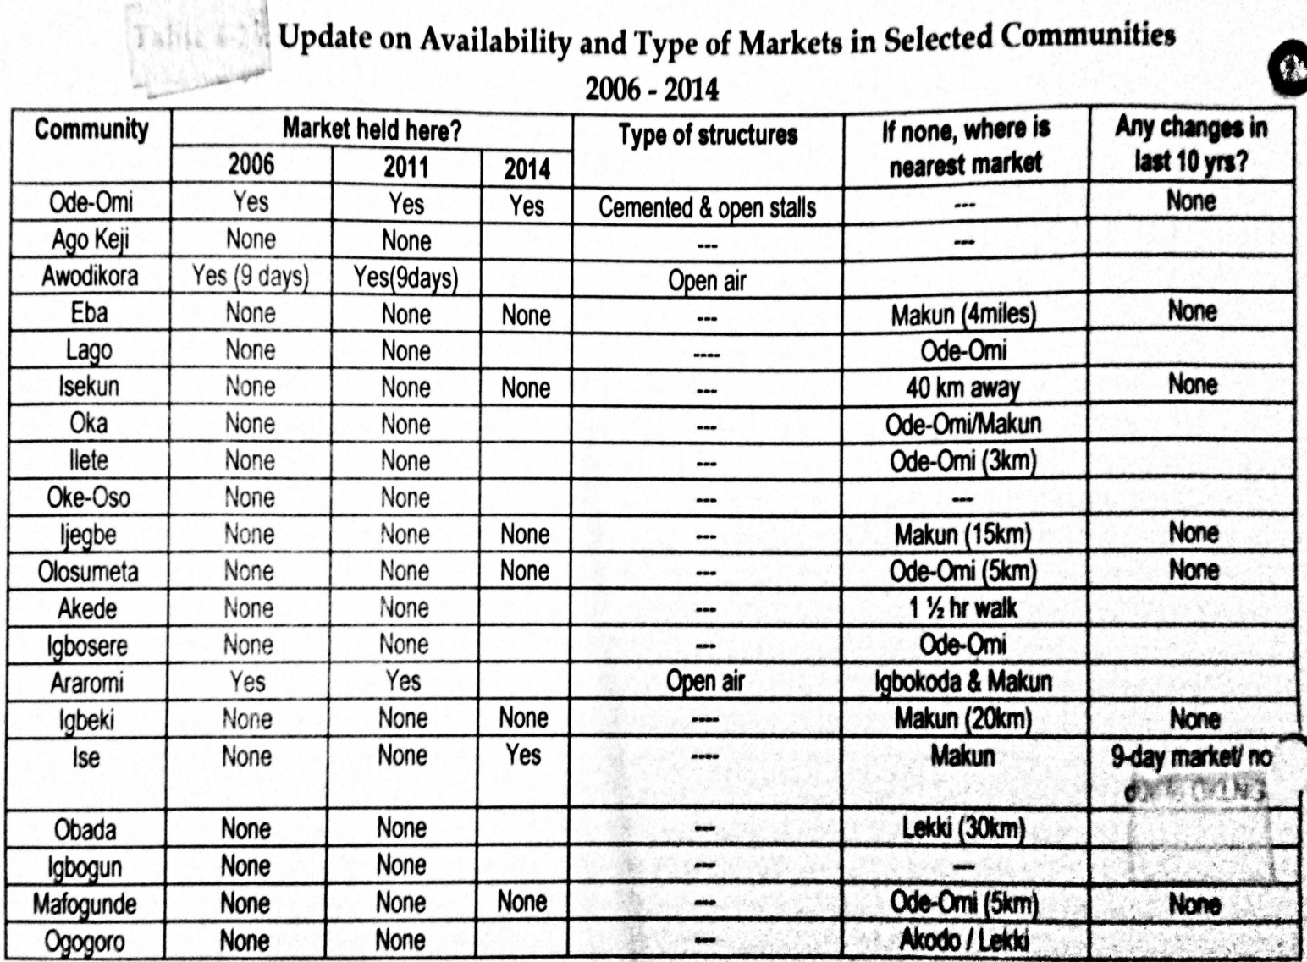
14.0

Slide 34
15.0 CONCLUSION
Ogun State Coastal Area is in dire need of infrastructure like protection against invasive plants and ocean surges, schools, hospitals, markets, roads, electricity, improved transportation, and agricultural value chain facilities,.
This is more important when considering the adjacent State opening up her adjoining communities to massive development, which invariably has turned Ogun State’s coastal areas into development pressure areas. In effort to have a sustainable development and environment, Ogun State’s coastal areas should begin to receive attention if it is not going to become endangered, even, when it has the capacity to host the deepest seaport in Nigeria.

Slide 35
Thank you all.

